Slide 1


RENTAL CODE SERVICE PROGRAMMING COMPANY
Rental Code Service
Programming Company is a company specializing in programming computer software projects, mobile applications, graphics, interfaces, games, web design and database design.

Slide 2



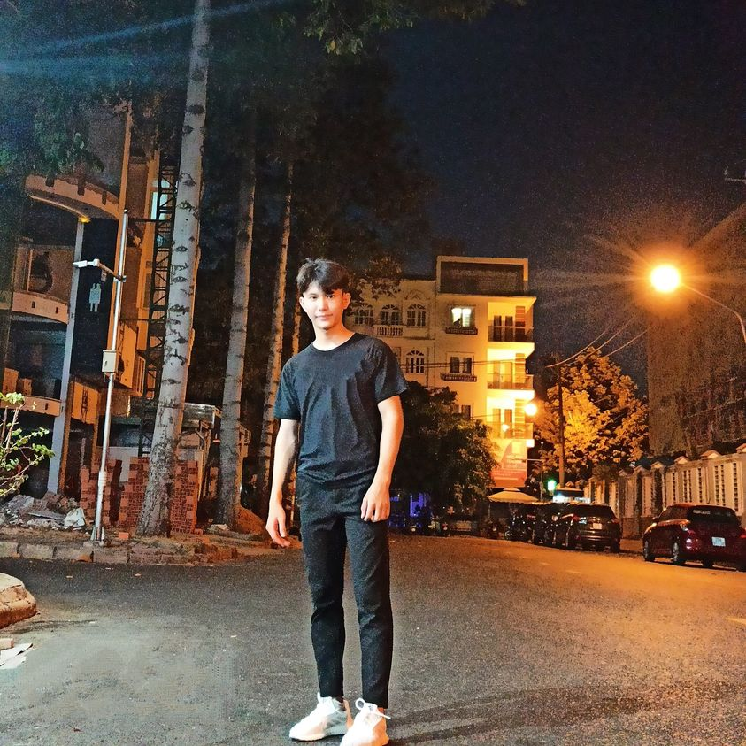
Members of Company
Tran Thanh Tam
(CEO of Rental Code Service programming company)
Managing all activities of Rental Code Service programming company.
Nguyen Van Dung
(Head of coder department of Rental Code Service programming company)
He manages the programming and design of the project.

Slide 3




Vuong Trong Tin
(Secretary of Rental Code Service programming company )
He will manage all information and data in the company.
Nguyen Phu Quy
(Marketing Manager of Rental Code Service programming company)
He will be in charge of promoting the company's image

Slide 4


Features
Computer software programming, mobile applications(about 1000 dollars/project)
Our company receives programming or support to make computer software and phone applications on demand and then sell it to customers.

Slide 5

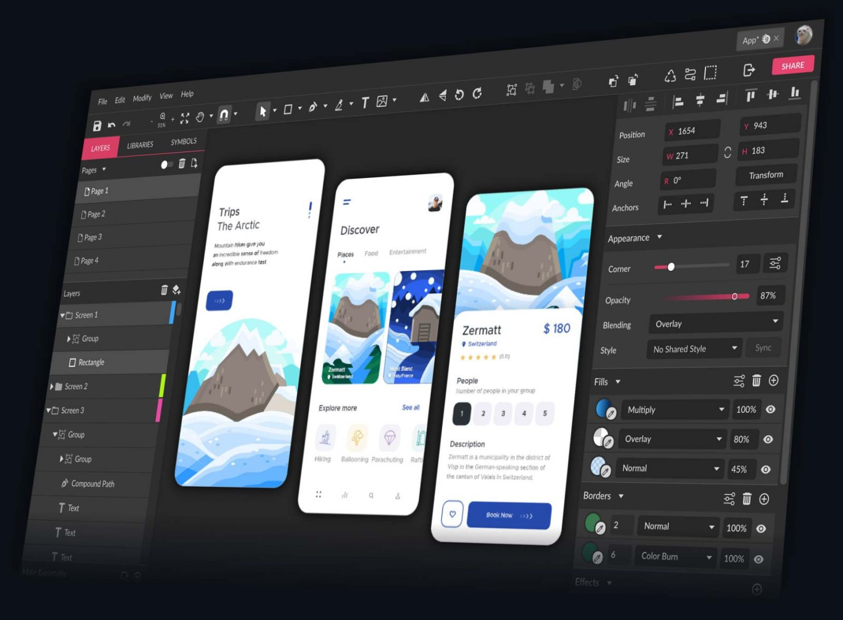
Create graphics, interfaces(about 500 dollars/project)
Create graphics and interfaces for application software on the market to help customers when they can't do it all

Slide 6

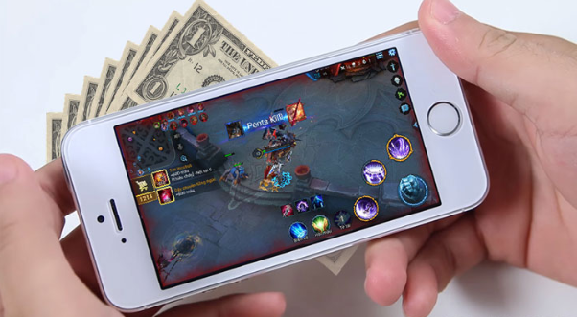
Programming Games(about 5000-10000 dollars/game)
Here we make offline and online games on mobile phones and run them on Android and IOS operating systems, then bring them to market to serve customers.

Slide 7
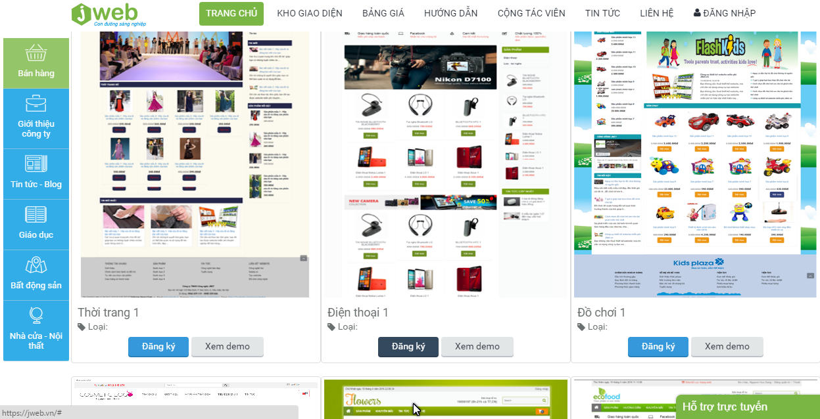


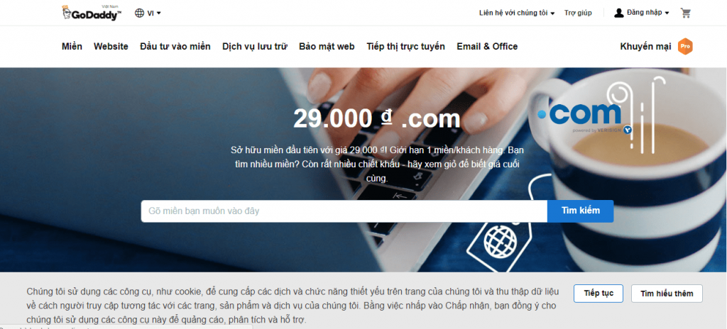
Web design(about 100-150 dollars/website)
Create custom websites to advertise their products

Slide 8

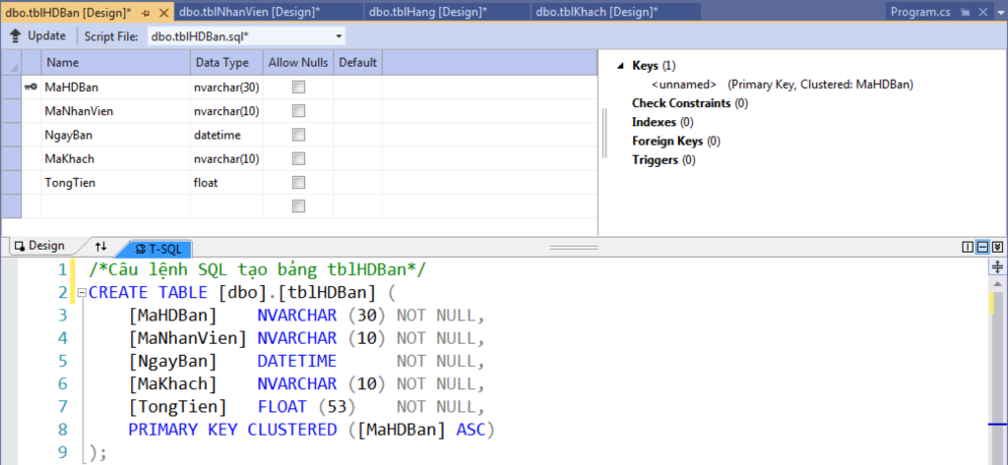

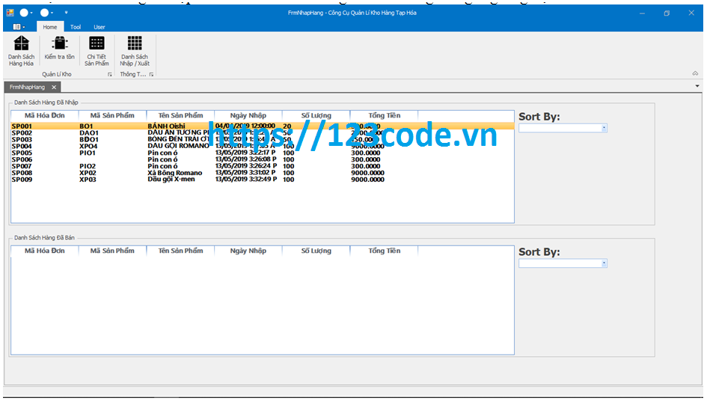
Database Design(about 500 dollars/project)
Create a database for customers to easily manage information about their business

Slide 9
Questions Answers to most common questions.
*Why use our service?
→ Using services from reputable, branded sources helps you feel secure in transactions & agreements.
*How to pay fees?
→Payment by bank transfer 20% in advance.
*Is the project delivery time guaranteed?
Commitment to ensure the time as promised by both parties.
*Is the code the same on the internet?
→The source code commitment we provide is not duplicated, not available on the network (With a large assignment code rental service).
*Do you compensate for not doing your duty properly?
→100% refund if you do not do your responsibilities properly.
*Do you have a warranty when delivering the product to the customer?
→Commit to warranty service even after handing over the code, ensuring your code will run correctly and have all the features as required.

Slide 10
Contact us
Address: 87 Nguyen Huu Tho, Tan Hung Ward, District 7, Ho Chi Minh City
Email: DragonKing@gmail.com
Phone number:15304730945
Or visit the Website:www.dragonkingcompany.com.vn

